Slide 1
Capstone Project
Hotel Booking Analysis By: Manisha Dhanuka

Slide 2
What to expect in next few slides:
Importance of data analysis for the hotel industry.
Problem Statement
Data Pre-processing
Understanding the trends and demands
Cancelled Bookings analysis
Average Daily Rate Analysis

Slide 3

Why analysis of hotel booking data?
The hotel industry is one of the most important components of the wider service industry, catering for customers who require overnight accommodation. It is closely associated with the travel industry and the hospitality industry.

Slide 4
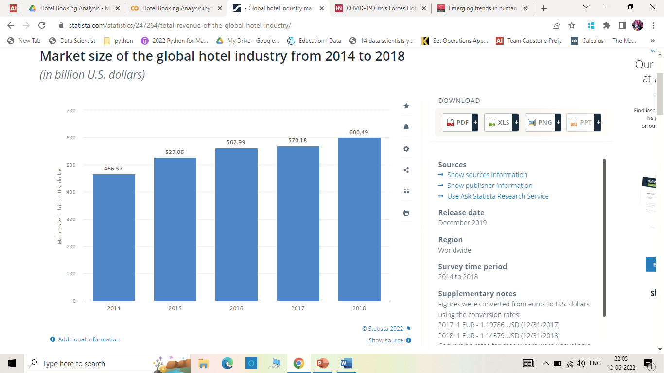
Market size of the global industry from 2014 to 2018 (in billion U.S. dollars)

Slide 5
Continued…
Moreover, the industry contributes 10.4% of global GDP, supporting one in ten jobs on the planet.
In 2019, the tourism industry contributed around 9 percent to India’s GDP and generated 87.5 million jobs, which is about 12.75 percent of total employment of 2018-19, according to the World Travel and Tourism Council (WTTC).
It can affirm that the tourism industry is one of the principal job providers.
Like every other sector of economy, hospitality sector is also not immune to the ebbs and flows of the uncertainties. As such, one should keep an eye on the critical business statistics to better redefine one’s serving offerings.

Slide 6

Problem Statement
Two hotels: Resort Hotel and City Hotel’s booking data was with us. We first understand the data and explored about the booking trends over the time, the demands and trends for the various services, possible reasons of cancellation and how the ADR is changing over time.

Slide 7
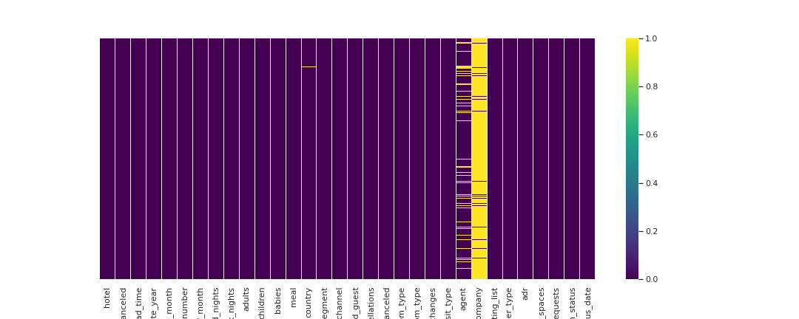
Data Pre-processing:
There were null values in children , company, agent and country column. We impute them accordingly except for country column as it was not obvious.

Slide 8
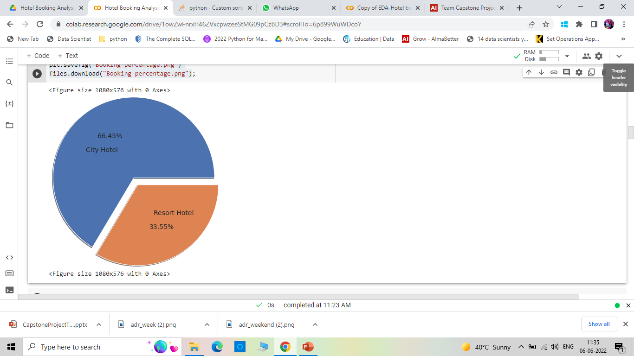
Booking distribution per hotel:
Out of total 12000 booking data, nearly 80,000 bookings were for the City Hotel and 40,000 of that of Resort Hotel.

Slide 9
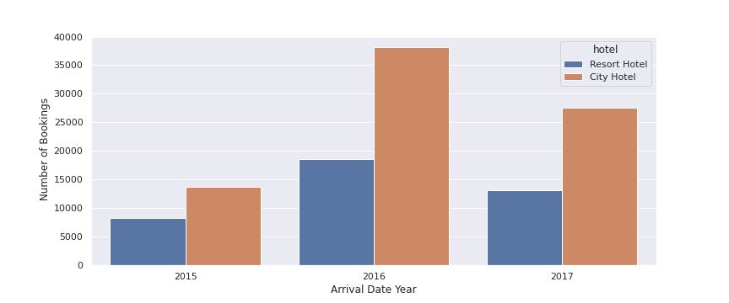
Booking over the years

Slide 10
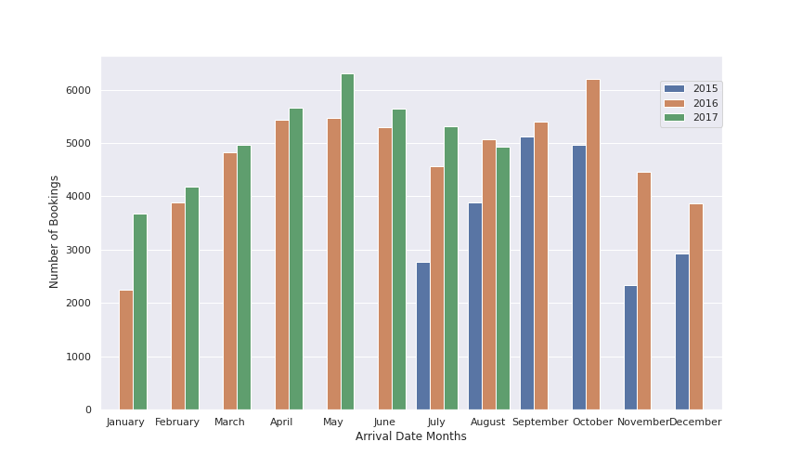
Busiest months for the hotel?
Number of bookings is increasing per year.
Maximum bookings are in May and October month.
The months in between have fair bookings but the extreme months have less bookings.

Slide 11
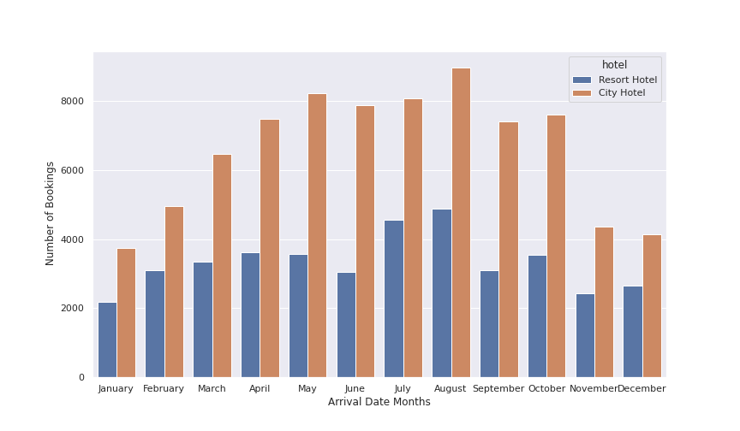
Was monthly trend same for both the hotels?
Yes, the data shows that trend for both the hotels are same when it comes to monthly bookings.

Slide 12
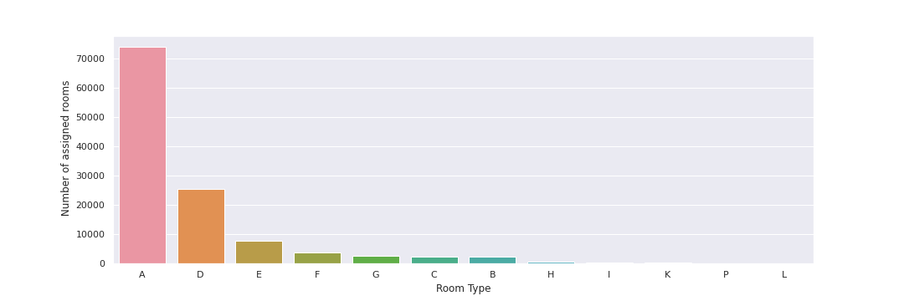
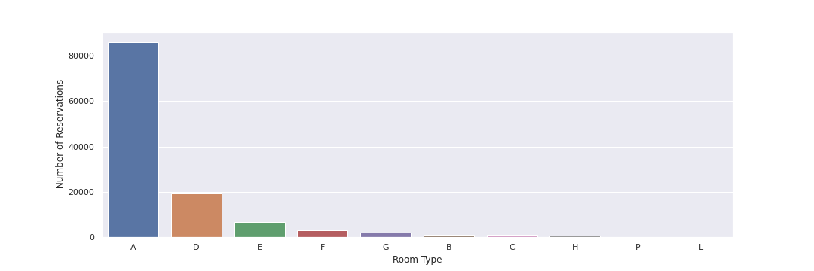
Preferred Vs Allotted room Type?
Clearly most preferred room type is A but there are nearly 1000 instances where the reserved room type was A, but the hotel staff allotted them some other room.

Slide 13
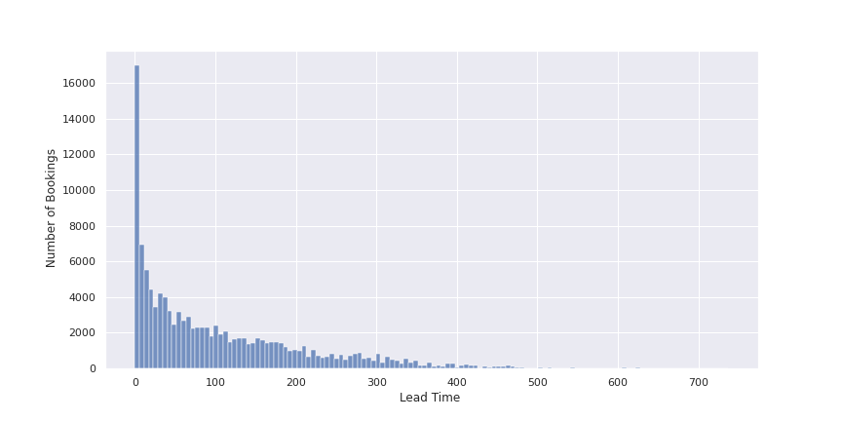
Lead Time of the bookings
Lead time is an indicator of pre-bookings and last minute bookings. Lead time is positively skewed with average lead time of 104 days i.e., most of the bookings are done last minute. But the range is from 0-700 days. Thus, we can say there are some instances of 2 years prior booking.

Slide 14
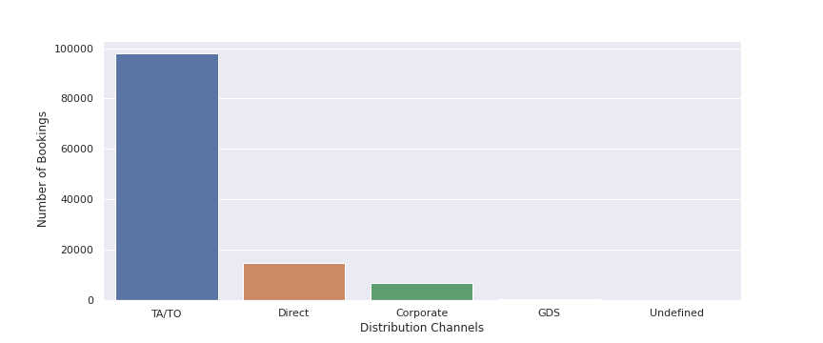
Contribution of various distribution channels to the bookings
Most of the bookings is coming from Travel agencies and tour operators. Very less direct bookings in comparison to them.

Slide 15
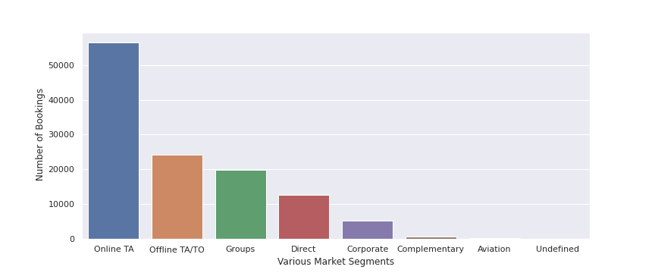
Marketing strategy Considerations:
The bookings from various market segment indicates that most of the tourist are there for leisure and considerable number of people travel in groups too. Very few are from the corporate market segment.

Slide 16
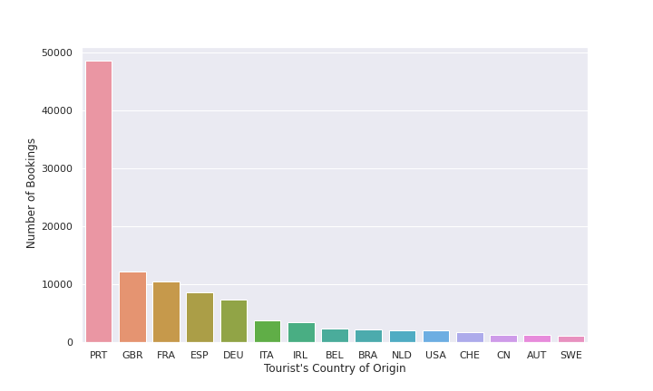
Top 15 countries
People from Portugal, Great Britain, France, Spain and Germany visited hotel the most.

Slide 17
Booking Cancellation Analysis:
Are number of days in waiting list is linked to cancellation or not?
If most of the cancellations were from repeated guests or the new guests?
The number of tourists who have previously cancelled the bookings too.
Tourist Cancellation with respect to deposit type.

Slide 18
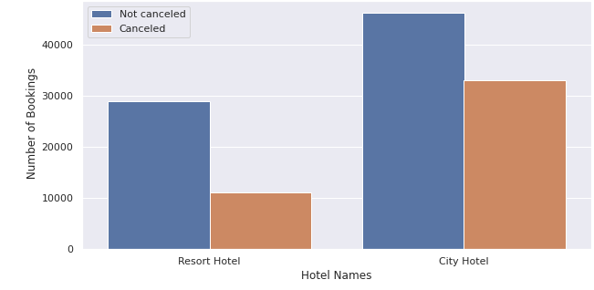
Cancellation Statistics
Although number of bookings for resort Hotel was less but the cancellation rate for it is also less, that is 27% in comparison to 41% of the City Hotel.

Slide 19
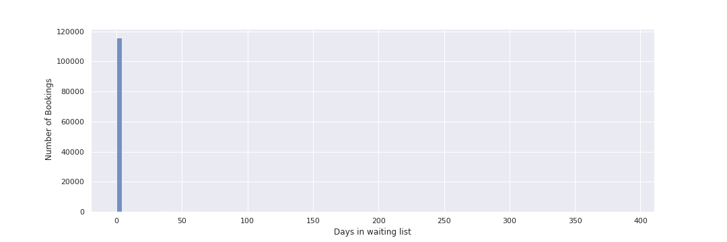
Days in waiting List
Most of the bookings have 0 days in waiting list which confirms the modal lead time of 0. But the range of 400 days is quite worrisome. Let us zoom it little bit to better understand it

Slide 20
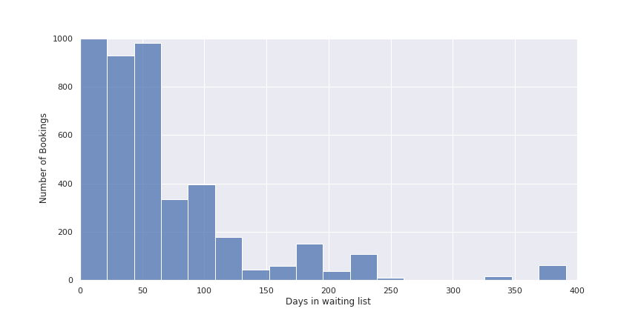
Zoomed…

Slide 21
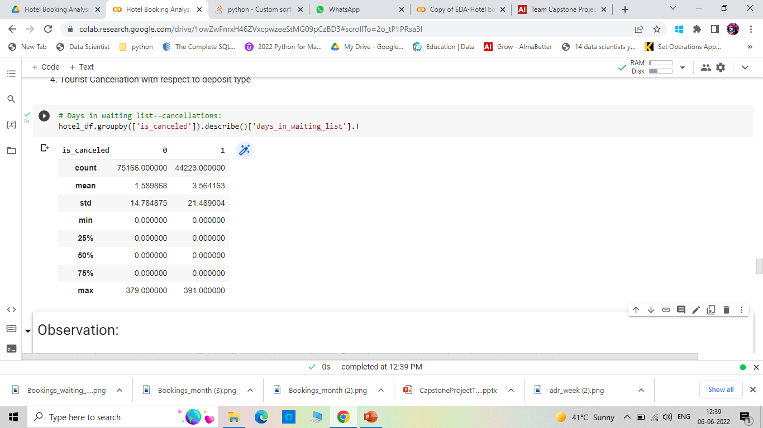
Are number of days in waiting list is linked to cancellation or not?
Average waiting day for the bookings cancelled is nearly 3.5 days with deviation of 21 days and for the one not cancelled is 1.5 days with deviation of 14 days.
75% of the bookings fall under 0 waiting days.
Maximum waiting day for both are nearly same. Thus, less chances of waiting days affecting the cancellation rate.

Slide 22
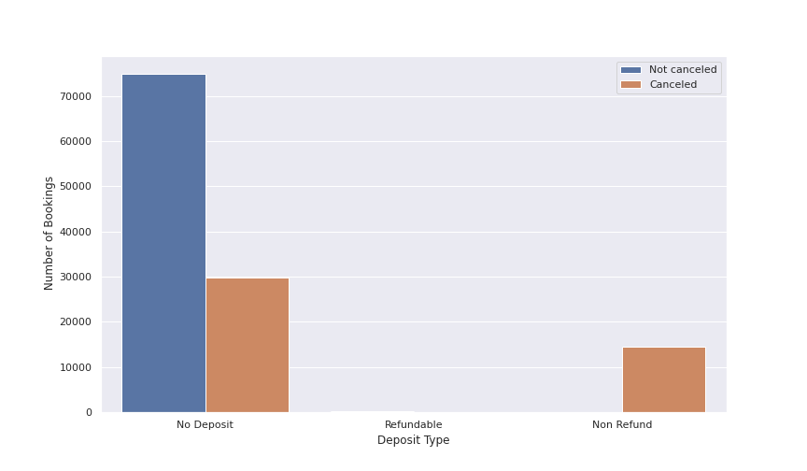
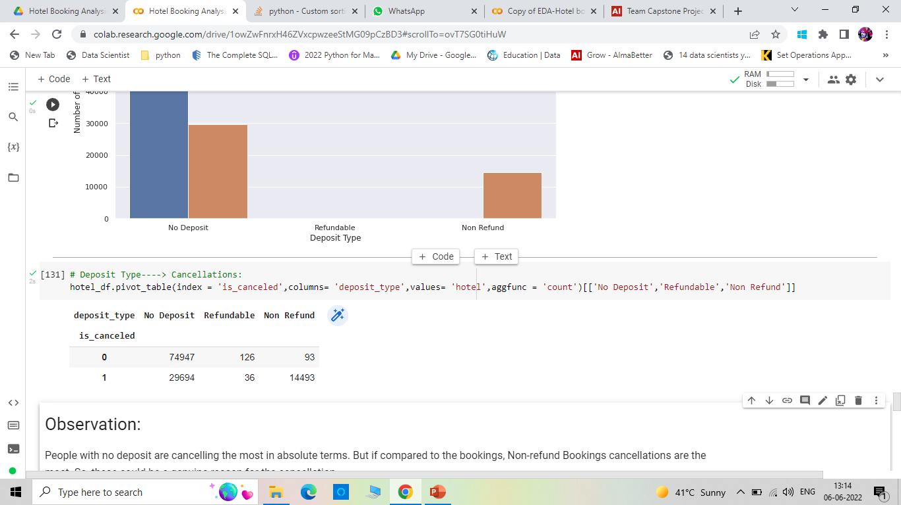
Does deposit type affect the cancellation?
Clearly, this is not the case. Since cancellations are more from non-refundable deposit type bookings than the refundable one.

Slide 23
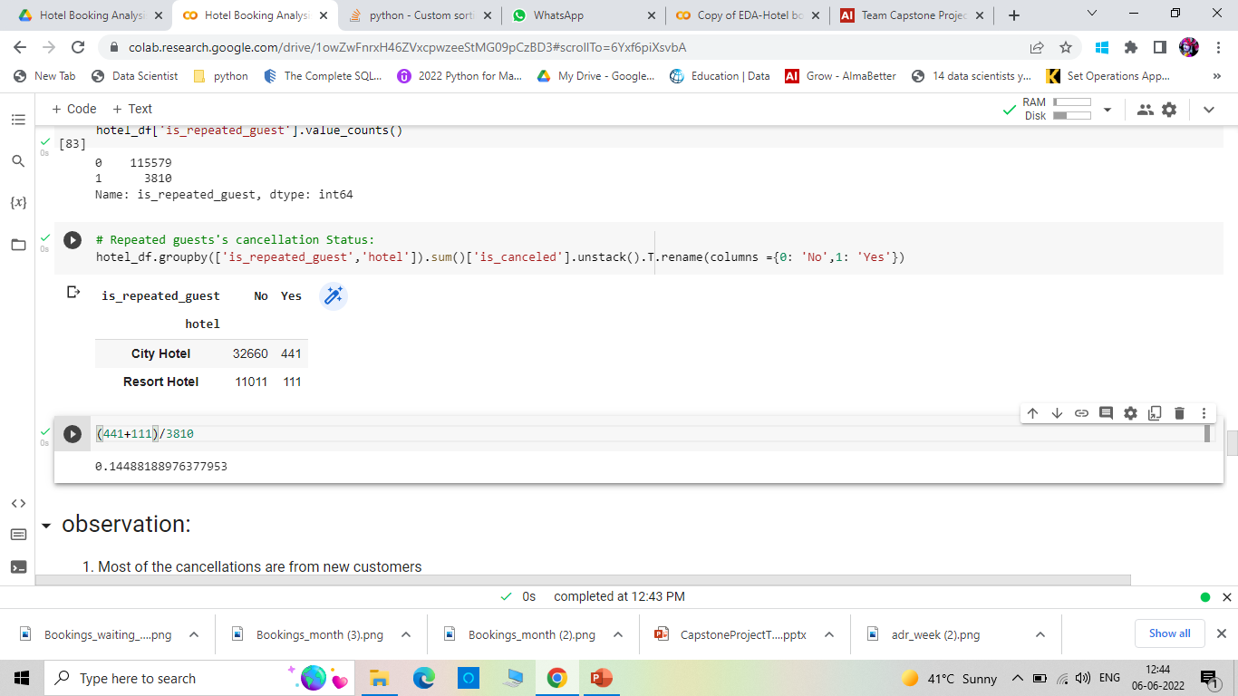
If most of the cancellations were from repeated guests or the new guests?
Most of the cancellations are from new customers.
Although 14 % i.e. Nearly 550 out of 3810 guests who consider the hotel again, canceled the bookings. Thus, hotel should contact them to know their reasons or feedbacks for more customer retention.

Slide 24
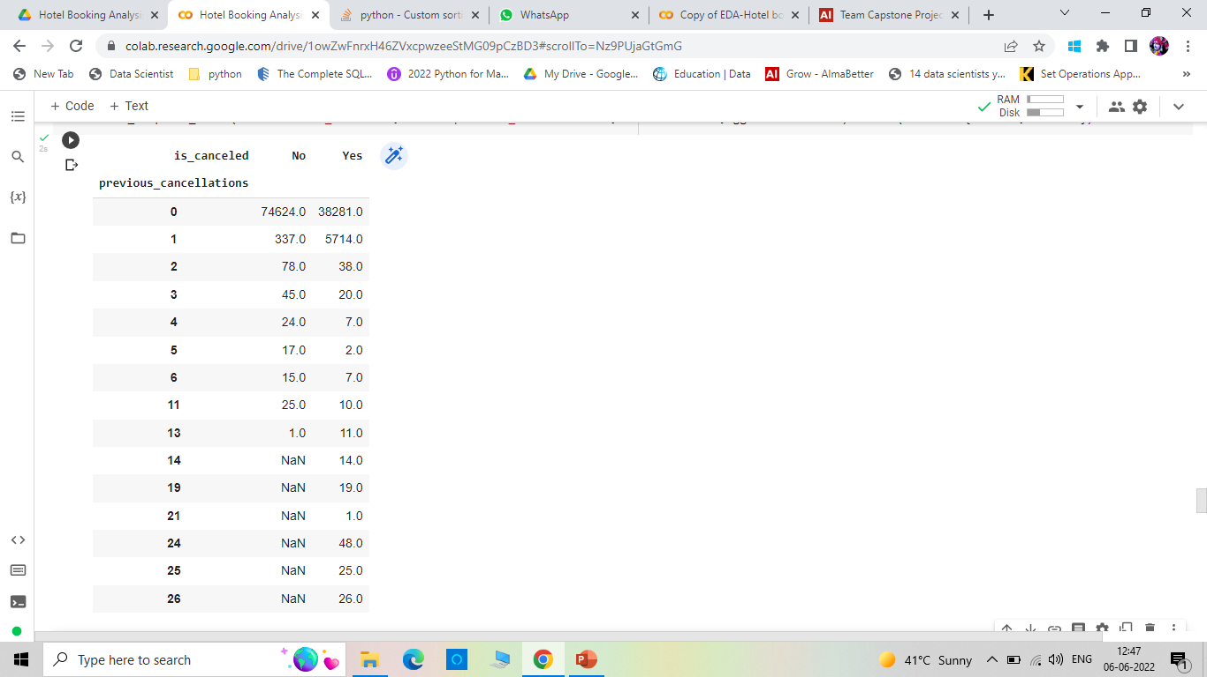
The number of tourists who have previously cancelled the bookings too
All tourists with more than 13 cancelations are actually cancelling most, in fact all of their bookings and moreover most of the data values are duplicate here when explored further. They are either mass bookings who could be the habitual nuisance or there is technical glitch while saving the data.

Slide 25
Average Daily Rate
The average daily rate (ADR) is a useful tool to maximize revenues in the hospitality sector.
The ADR is measured as the total revenues generated by all the occupied rooms in the hotel or lodge divided by the total number of occupied rooms over a given time period.
The average daily rate includes only the occupied rooms and not the total available stock.

Slide 26
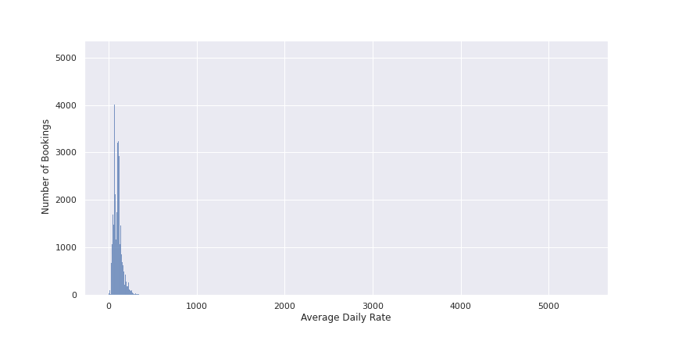
Average Daily Rate

Slide 27
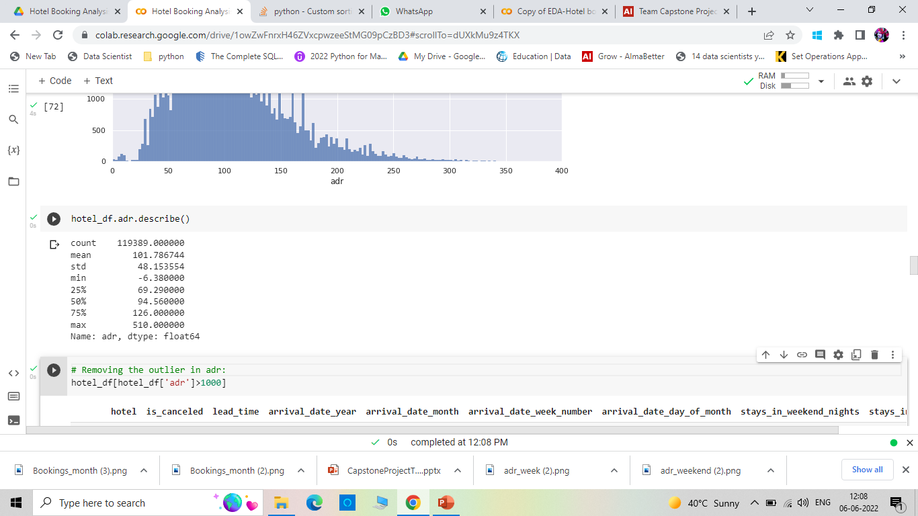
ADR Statistics
ADR follows nearly normal distribution after removing an outlier of 5040 in comparison to all the values less than 510. the average ADR irrespective of room type is 101 units.

Slide 28
Average Daily Rate Analysis
How lead time affects ADR
Do bookings on weekends vs on week days affect the revenue
How ADR is varying over the years.
ADR with respect to various room types
Contribution of various market segments to ADR
Contribution of various distribution channels to ADR

Slide 29
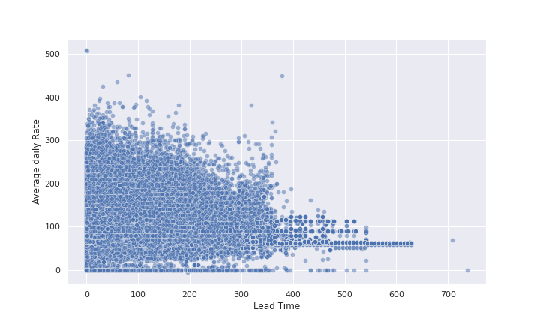
Lead Time and ADR
With increase in Lead time, ADR keeps on decreasing.
For the advanced bookings with1 year gap, the Average daily rate is nearly same and is about 100 to 150 units.

Slide 30
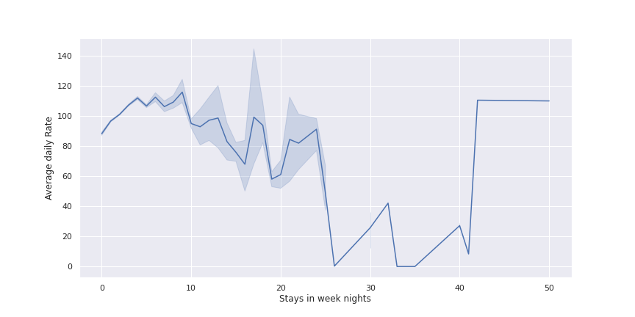
Variation with number of stays on week nights
For nearly 8 days stay, the ADR keeps on increasing. But if the stays extend for more than that, it does decrease, but the decrease is not so prominent. It does not show a particular trend. It keeps on oscillating.

Slide 31
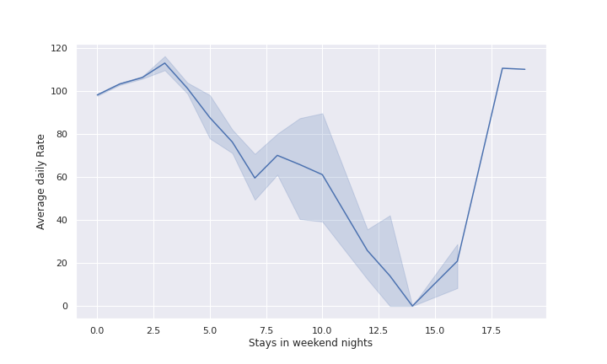
Variation with number of stays on weekend nights
ADR for weekend nights is more in comparison to week days.
After more than 3 weekend stays, the ADR decreases a lot that justifies decrease of ADR for more than 13 days stay in week days.

Slide 32
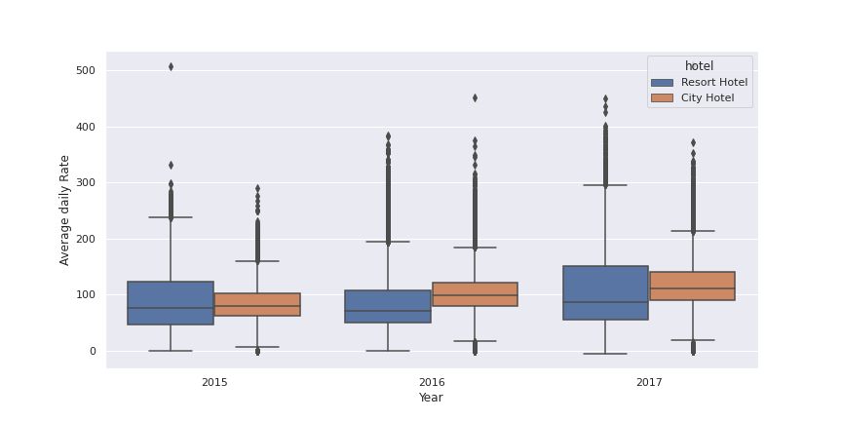
Average Daily Rate per year
ADR over years hardly increase.
ADR for city hotel was more than the resort Hotel in 2016.

Slide 33
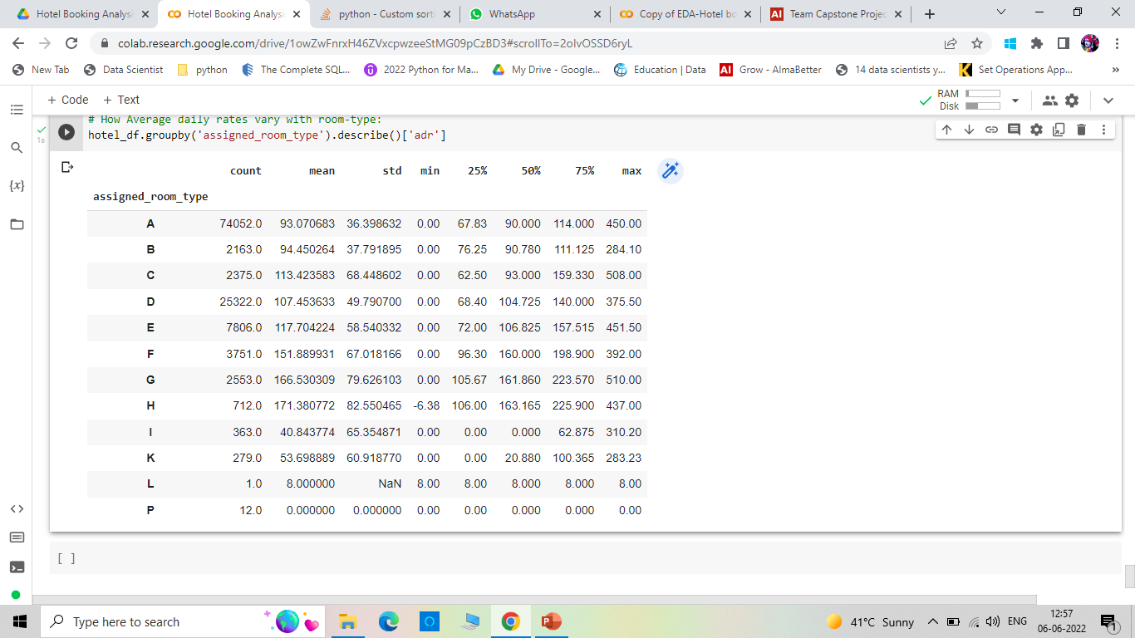
ADR for different room types

Slide 34
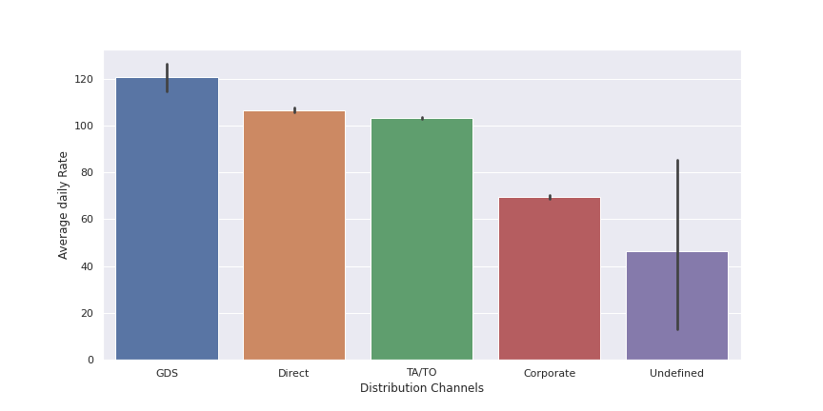
ADR for various Distribution Channels
Number of bookings by GDS was very less, but the average ADR is more for them. Thus, if prices are reduced for them, there could be a chance of more customers from them.
Also, ADR for the corporate is less but the number of bookings is also very less.. Should look upon this and provide them with necessary facilities.

Slide 35
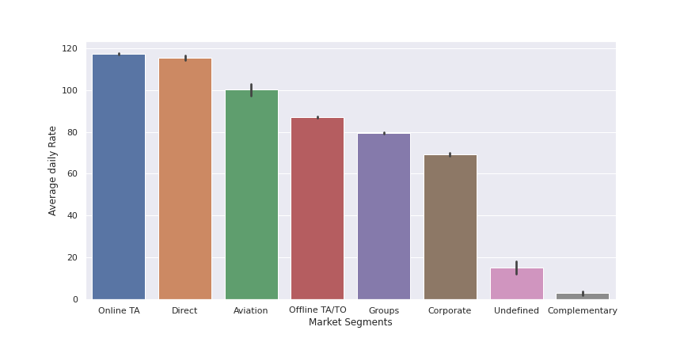
ADR for various Market Segments
Clearly, online TA are bringing more bookings as well as more revenue,, thus the online campaign is doing good.
Direct bookings were less but the ADR is nearly same. Can increase the number by investing in making online direct presence by the introduction of websites and offers.

Slide 36
Conclusions
For both hotels, mid-year is really good. They need to be well prepared for the busy period.
Portugal, Great Britain and France are the potential countries, should invest in more market campaigning there.
Direct Bookings is less and possible reason could be less popularity, should display hoardings on the public places an go for the hotel website as Online TA are doing good, reason could be people preferring online booking more.
People with non-refundable deposit type cancelling the bookings, which is not natural. Hotel should contact them and solve their concerns if any, about the hotel.
Should increase the room type A, as availability is less than the demand for it
Very few repeated guests are there. Shall contact them for their feedbacks or ratings.

Slide 37
Thank You

